Slide 1
Red Bots Do It Better: Comparative Analysis of Social Bot Partisan Behavior
From the 2019 World Wide Web Conference
By Luca Luceri*, Ashok Deb†, Adam Badawy†, and Emilio Ferrara†
* University of Applied Sciences and Arts of Southern Switzerland, and University of Bern
† USC Information Sciences Institute
Presented by Shawn M. Jones
Old Dominion University
CS 895: Web Archiving Forensics, Fall 2020

Slide 2
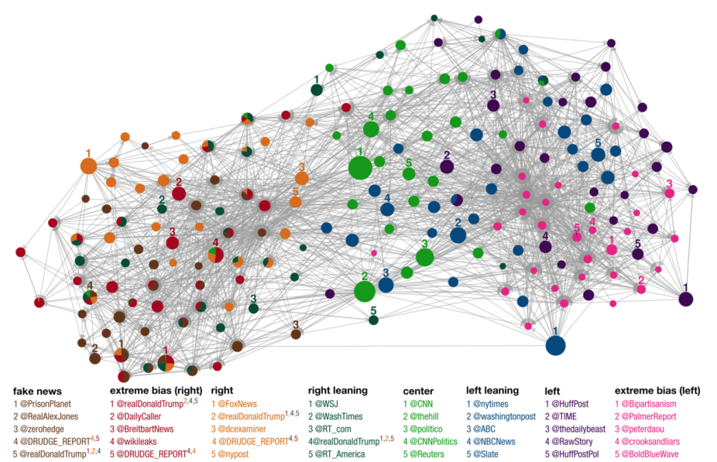
Disinformation campaigns contribute to social media manipulation
Alexandre Bovet and Hernán A Makse. 2019. Influence of fake news in Twitter during the 2016 US presidential election. Nature communications 10, 1 (2019), 7. https://arxiv.org/abs/1803.08491
Nir Grinberg, Kenneth Joseph, Lisa Friedland, Briony Swire-Thompson, and David Lazer. 2019. Fake news on Twitter during the 2016 U.S. presidential election. Science 363, 6425 (2019), 374–378. http://doi.org/10.1126/science.aau2706

Slide 3
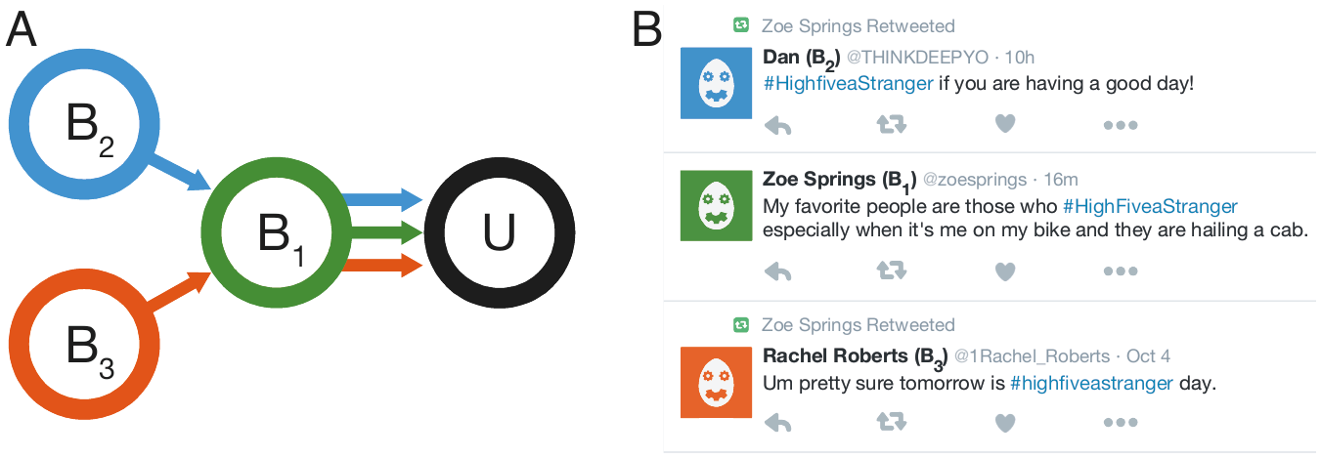
Social bots are a factor in social media manipulation
Mønsted B, Sapieżyński P, Ferrara E, Lehmann S (2017) Evidence of complex contagion of information in social media: An experiment using Twitter bots. PLOS One 12(9): e0184148. https://doi.org/10.1371/journal.pone.0184148
Alessandro Bessi and Emilio Ferrara. 2016. Social bots distort the 2016 US Presidential election online discussion. First Monday 21, 11 (2016). https://firstmonday.org/article/view/7090/5653

Slide 4
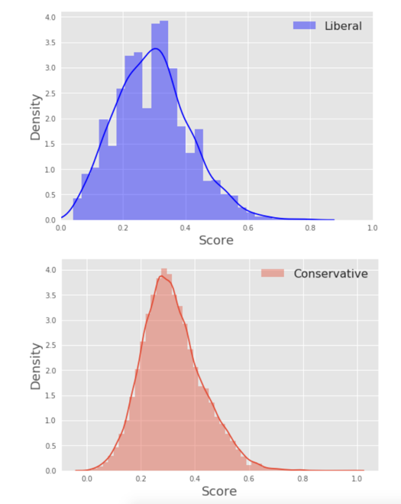
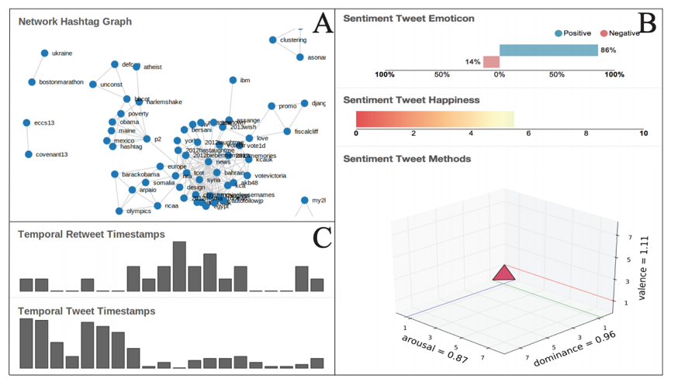
Elections are good examples of the perils of mass manipulation of political discourse and bots play a pivotal role
Adam Badawy, Emilio Ferrara, and Kristina Lerman. 2018. Analyzing the Digital Traces of Political Manipulation: The 2016 Russian Interference Twitter Campaign. In Int. Conference on Advances in Social Networks Analysis and Mining. 258–265.
https://arxiv.org/abs/1802.04291
Emilio Ferrara, Onur Varol, Clayton Davis, Filippo Menczer, and Alessandro Flammini. 2016. The rise of social bots. Commun. ACM 59, 7 (2016), 96–104. https://doi.org/10.1145/2818717

Slide 5
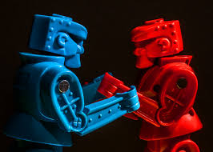
The authors had 3 research questions
Do social bots lean and behave according to a political ideology?
Can we observe different strategies among liberal and conservative bots?
Are bot strategies effective?

Slide 6
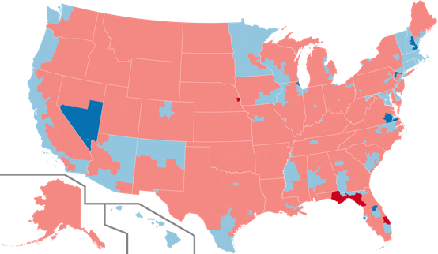
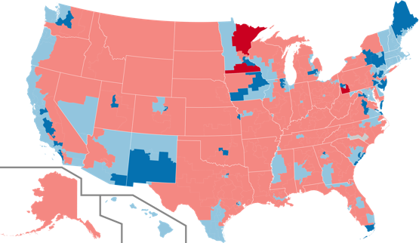
With Twython, the authors collected 2.6 million tweets from the time around the 2018 elections
42 days
Tweets with keywords:
2018midtermelections
2018midterms
elections
midterm
midtermelections
# of tweets: 452,288
# of retweets: 1,869,313
# of replies: 267,973
# of users: 997,406
October 6, 2018
November 6, 2018
2018
United States House of Representatives elections
November 19, 2018
image source:
https://en.wikipedia.org/wiki/2016_United_States_House_of_Representatives_elections
image source:
https://en.wikipedia.org/wiki/2018_United_States_House_of_Representatives_elections

Slide 7
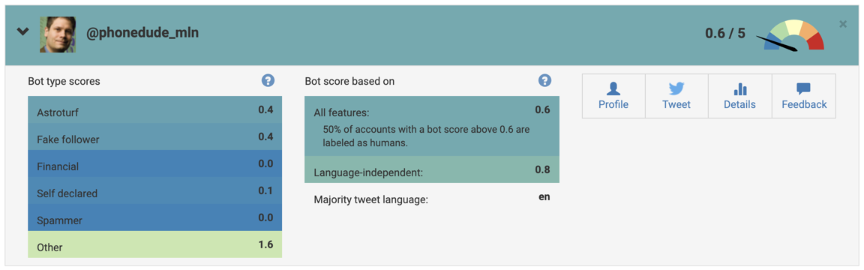
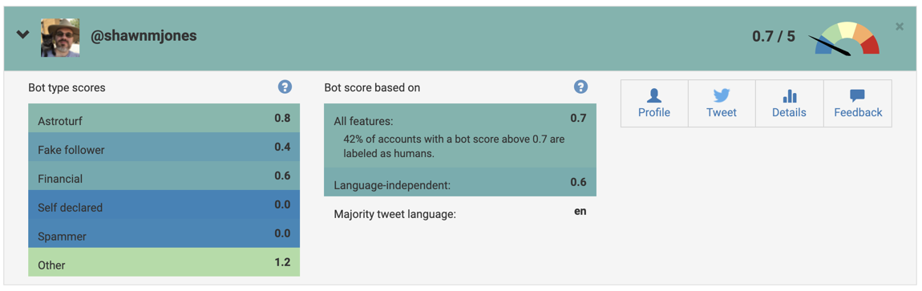
Botometer uses different features with Random Forest to predict that an account is a human or a bot
Clayton Allen Davis, Onur Varol, Emilio Ferrara, Alessandro Flammini, and Filippo Menczer. 2016. Botornot: A system to evaluate social bots. In Proceedings of the 25th International Conference Companion on World Wide Web.
Onur Varol, Emilio Ferrara, Clayton A Davis, Filippo Menczer, and Alessandro Flammini. 2017. Online human-bot interactions: Detection, estimation, and characterization. In Int. AAAI Conference on Web and Social Media. 280–289.
Kai-Cheng Yang, Onur Varol, Clayton A Davis, Emilio Ferrara, Alessandro Flammini, and Filippo Menczer. 2019. Arming the public with artificial intelligence to counter social bots. Human Behavior and Emerging Technologies (2019), e115.
https://botometer.osome.iu.edu/

Slide 8
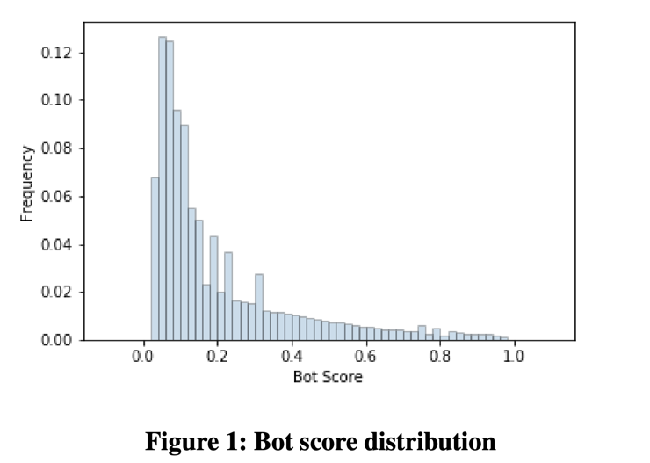
According to Botometer, 21.1% of the accounts in the dataset of 2.6 million tweets are bots
<– humans
bots →
With Botometer v3 a score of 0.3 or greater is likely a bot
35,029 (3.5%) of the accounts could not be scored
Twitter had suspended 99.4% of them
the remaining had switched from public to private

Slide 9
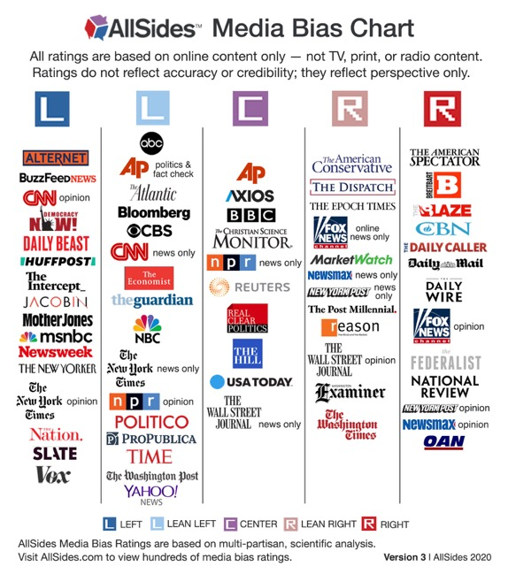
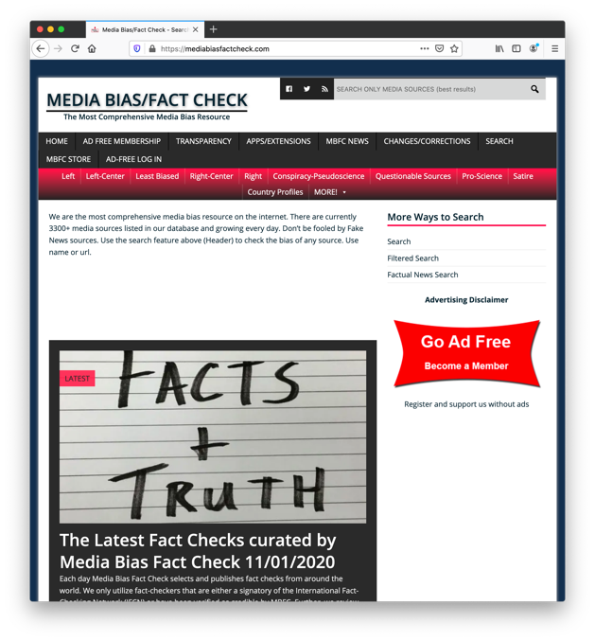
They categorized each account as either liberal or conservative based on the type of URL most frequently tweeted as classified by these services
https://www.allsides.com/media-bias/media-bias-ratings
https://mediabiasfactcheck.com/

Slide 10
A small number of conservative bots produced more tweets than liberal ones and almost as many as conservative humans
User counts
 | Conservative | Liberal
Humans | 386,391 (38.7%) | 122,761 (12.3%)
Bots | 82,118 (8.2%) | 49,488 (4.9%)
The tweet-per-user ratios
conservative bots produce 7.4 tweets per account
conservative humans produce 3.9 tweets per account
liberal bots produce 3.5 tweets per account
liberal humans produce 2.5 tweets per account
Conservative bots tweet more than twice as much as liberal bots
Conservative bots tweet almost twice as much as conservative humans
Bots tweet more than humans
Tweet counts
 | Conservative | Liberal
Humans | 957,726 (37.0%) | 476,231 (18.4%)
Bots | 288,659 (11.1%) | 364,727 (14.1%)

Slide 11
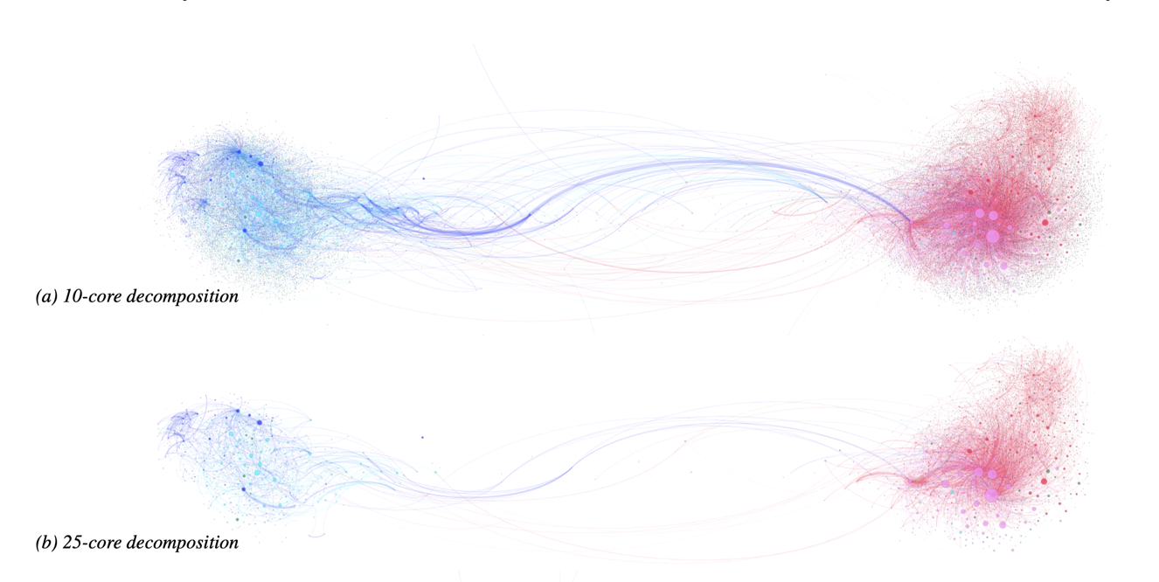
Each side is almost entirely populated by users with the same political ideology, but the right is more strongly connected
Nodes represent accounts
Edges represent retweets
red = conservative accounts
blue = liberal accounts
green = unclassified
purple = retweet between sides
Darker tones are bots
Lighter tones are humans
each node is at least connected to 10 other nodes
at higher values of k-core decomposition, the left is disrupted more, while the right stays well connected
each node is at least connected to 25 other nodes

Slide 12
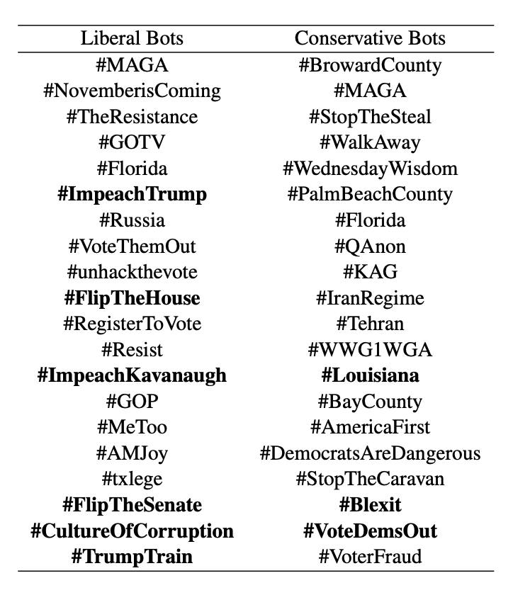
There are differences in the topics discussed by liberal and conservative bots
Bold hashtags:
“the hashtags that are not present in the top 50 hashtags used by the corresponding human group”
Observations:
conservative bots abide by the corresponding human counterpart more than the liberal bots
liberal bots focus on more inflammatory and provocative content (e.g., #ImpeachTrump, #ImpeachKavanaugh, #FlipTheSenate) with respect to conservative bots

Slide 13
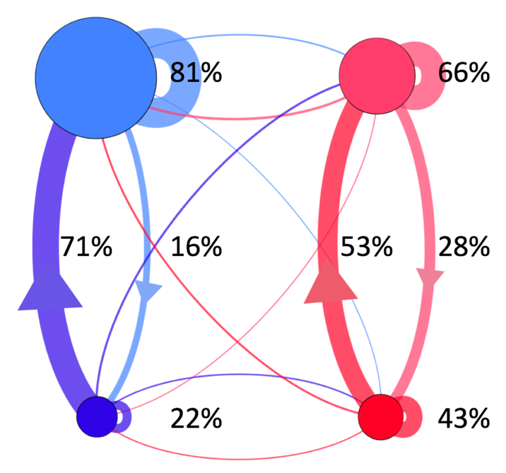
Most interactions are between those of the same political leaning
Humans
Liberal humans retweeted other liberal humans more than conservative humans
Liberal bots mainly retweeted liberal humans 71% of the time.
Conservative humans interacted more with conservative bots
Conservative bots retweet themselves 43% of the time.
Bots

Slide 14
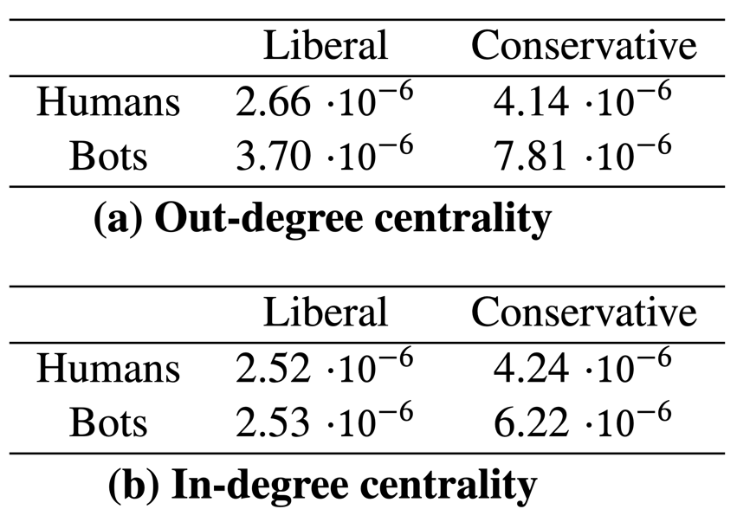
Conservative groups have higher centrality measures than liberal ones
Out-degree measures the quantity of retweets given
In-degree measures the quantity of retweets received
The conservative side is far more connected by retweets → higher centrality

Slide 15
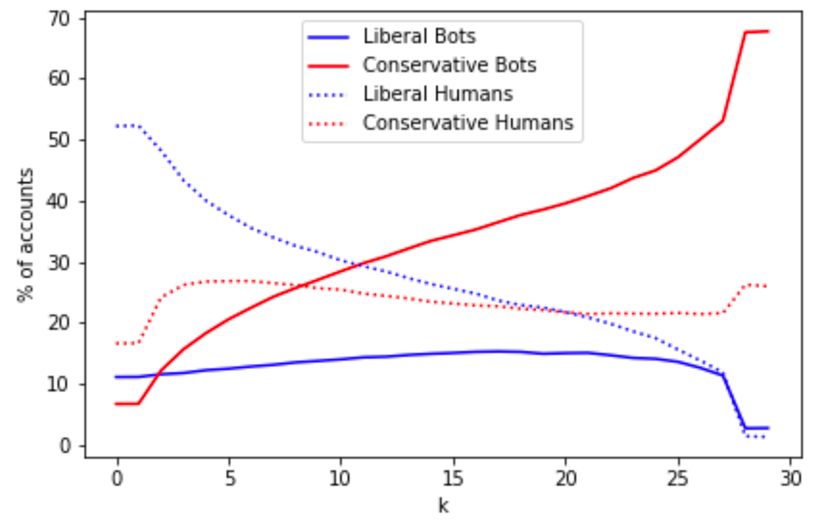
Conservative bots sit in a more central position than liberal bots and are more deeply connected
k-node decomposition – a subgraph of the whole where:
k = # of nodes to which a node has a degree >= k
where degree is based on the the number of retweets
as k grows the # of conservative bots grows, but the # of liberal bots stays stationary
70% of the conservative bots are connected to at least 30 other accounts through retweets

Slide 16
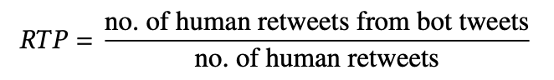
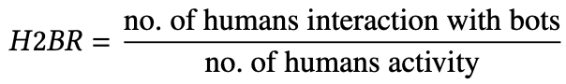
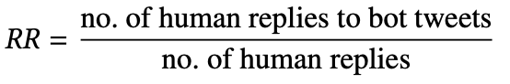
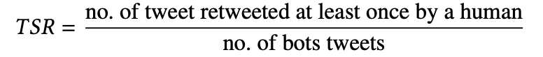
The authors measured bots according to four metrics
intrusiveness of bot-generated content vs. human-generated content
human interaction with bots vs. all human interaction
% of tweets by a bot that generated at least 1 retweet by a human
% of replies given by humans to bots

Slide 17
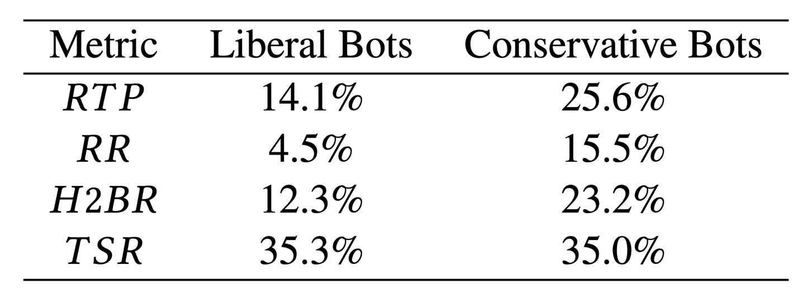
Conservative humans interacted more with conservative bots and conservative bots have more penetration within that group
intrusiveness of bots
replies from humans
to bots
human interaction
with bots
humans retweeting
bots

Slide 18
Conservative humans interacted with conservative bots almost twice as much with retweets
intrusiveness of bots
replies from humans
to bots
human interaction
with bots
humans retweeting
bots

Slide 19
Conservative humans interacted with conservative bots 3x as much with replies
intrusiveness of bots
replies from humans
to bots
human interaction
with bots
humans retweeting
bots

Slide 20
Almost 1 in 4 conservative human interactions go towards bots
intrusiveness of bots
replies from humans
to bots
human interaction
with bots
humans retweeting
bots

Slide 21
The small value is meaningful because: (1) TSR is inversely proportional to the number of tweets generated by bots (2) Conservative bots tweeted more than liberal ones
intrusiveness of bots
replies from humans
to bots
human interaction
with bots
humans retweeting
bots

Slide 22
Conservative bots are overall more effective than liberal bots
intrusiveness of bots
replies from humans
to bots
human interaction
with bots
humans retweeting
bots

Slide 23
RQ1: Do social bots lean and behave according to a political ideology?
Social bots are embedded in each political side
Conservative bots abide by the topic discussed by their human counterparts more than liberal bots
Liberal bots exhibit a more provocative attitude

Slide 24
RQ2: Can we observe different strategies among liberal and conservative bots?
Conservative bots stand in a more central social network position
Conservative bots divide their interaction between humans and other conservative bots
Liberal bots focus mainly on the interplay with human counterparts

Slide 25

RQ3: Are bot strategies effective?
The strategy of conservative bots is the most effective in terms of influence exerted on human users
Conservative bots received more interaction from conservative humans
Conservative humans retweeted bots twice as much as liberal humans
Conservative humans replied to bots 3 times as much as liberal humans
Almost 1 in 4 interactions from conservative humans was with a bot

Slide 26
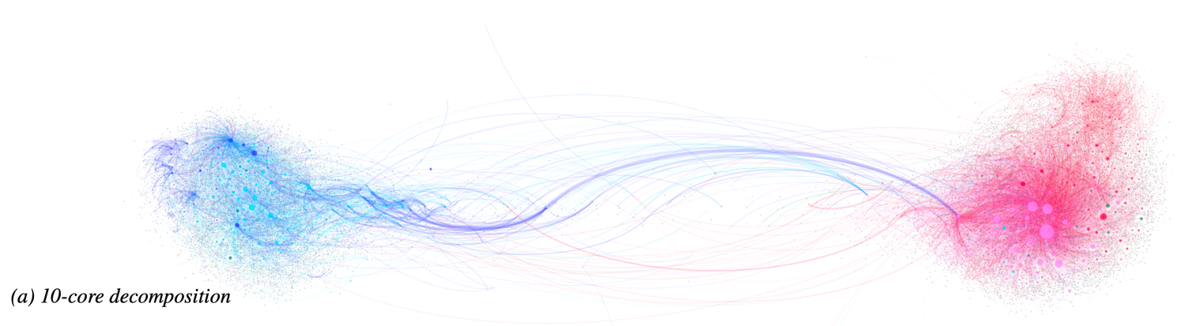
Conclusions and Future Work
The authors conducted a study of human and bot interactions on a dataset consisting of 2.6 million tweets from the time around the 2018 US elections
Conservative bots sat in a more central position in their social network
Conservative humans interacted more with conservative bots
Conservative bots had the more effective strategy, achieving more human interaction than liberal bots – red bots do it better
Future Work: Are conservative bots more effective due to their strategy or because the conservative humans could not tell they were bots?

